Slide 1

1
Lowe’s Campus Hackathon
Team Ragnarok
NIT Jamshedpur

Slide 2







Our Team
2
Prince Kumar
Ritik Raj
Harshal Desai
NIT Jamshedpur
NIT Jamshedpur
NIT Jamshedpur
Team Ragnarok

Slide 3
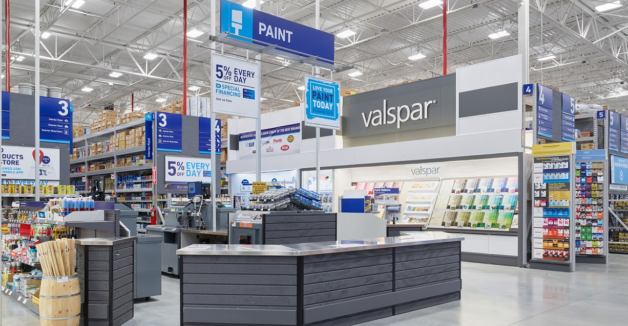
Objective
3
Problem
Statement: 3
Build a solution to help the customers find products in the store and help them navigate to the corresponding aisle/shelf. If there is a shopping list, provide the best shopping trip to complete the purchases

Slide 4




Problem Solution
4
Android Application
We developed an Android app with user-friendly UI & UX which solves all the challenges stated in Problem Statement like Finding Item’s Shelf location, Providing Shopping Trip and many more.
Scan Shopping List
Item Search
Shelf Location
User can take an image of Handwritten Shopping List and the app will extract all the items present in the list.
Find the Shelf location of Items in no time using its name, category or description.
Navigate to the required Shelf using Voice assistant and Integrated Shopping List for better Shopping Experience

Slide 5


Problem Approach
5
Scanning Shopping List
Searching Item’s Shelf location & availabilty
Locating items inside the Store
Shopping Trip & Voice Navigation
Optimal and Seamless shopping experience due to voice navigation system (used TextToSpeech class in java) and smartly sorted list, a/c to items' weight, size, floors, shelfs (implemented by Hash Map and comparator functions in java)
To extract items from a Image based Shopping list, Optical Character Recognition is used to convert text images to machine encoded text.
To enable the user to search items using its name, category or description, pattern matching is heavily used. So, we used the most efficient algorithm, KMP (time complexity - O(n))
To visualize the location of each shelf, (in each floor) in the store, shelf coordinates are marked in the Google Indoor Map of the store by the owner.

Slide 6
Work Flow
6
User selects the desired Products from Search Result and Add it to Shopping List
Search Item’s Location
Text Input
Searched using KMP String Matching Algorithm
Voice Input
Indoor Positioning System
Sorted Shopping List according to Shelf Number, Floor Number, Volume & Weight of Items.
The Item’s Shelf location and directions are constantly displayed on the Indoor Map of Store.
Voice based Navigation to complete the Shopping trip. It can also be used by visually Challenged Customers.
Final
Shopping List
Shopping Trip
Handwritten Shopping List
Capture Image of Shopping List
All the Extracted items gets added to shopping List automatically
Items Extracted from Image using OCR
Import Image from Gallery

Slide 7
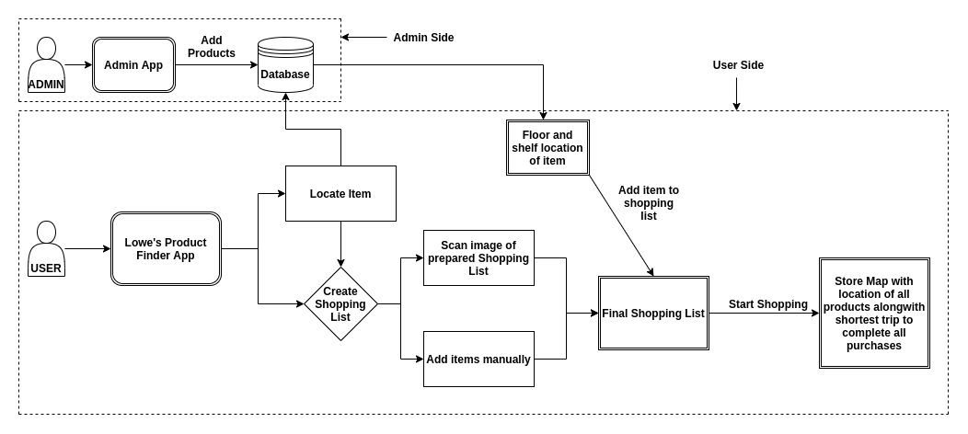
Architecture
7

Slide 8
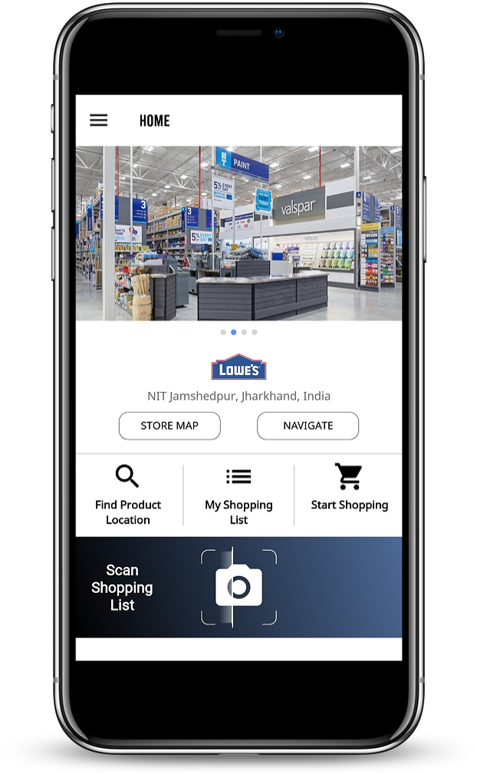
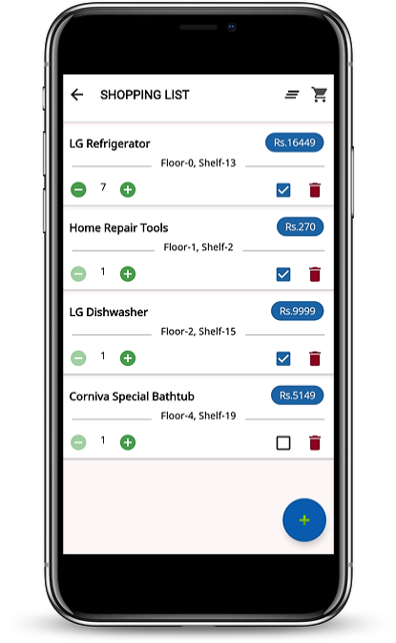
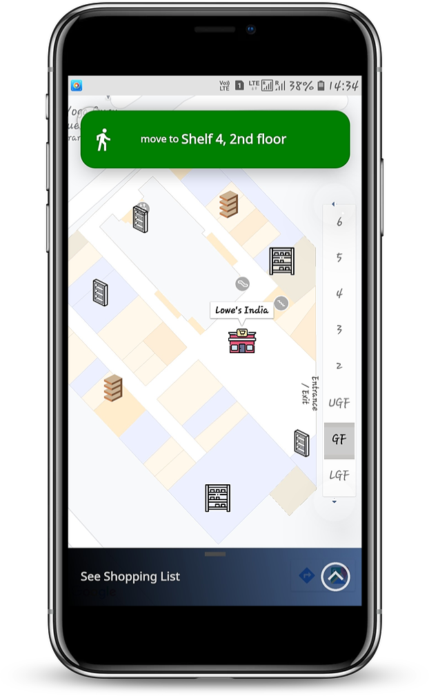



App Features
8
Smart Search
Shopping Trip
Find any Item’s Location & availability using Name, Category, Sub-Category or Description.
Shopping Trip using Voice Navigation, Shelf Directions & Smartly sorted Shopping List
Scan List
Shopping List
Scan Handwritten Shopping List and we will Search & Extract all the items in the image.
Import or Create your own Shopping list and Customize it as per your requirements.
Voice Navigation
Indoor Map
Get progressive voice based direction for each item
Floor wise Indoor map of Store to visualize location of each Shelves in the Store

Slide 9



Technology Stack
9
Technologies
Tools
1. Java
2. Android
3. NoSQL database
4. Optical Character Recognition
(Machine Learning)
1. Firebase
2. Google Maps
3. Git
4. GitHub
5. Android Studio
6. GSON

Slide 10




Challenges Faced
10
We faced and tackled the following challenges while working on this project
Image Capturing
Indoor Positioning
Versatility
Thumbnails were getting loaded after capturing image & image Orientation was changing with devices.
We stored the images in internal memory of device & loaded it by changing its Bitmap orientation.
Available solutions required to install huge no. of Sensors and Cameras in the Store: Not feasible
We did some research and found Google's Indoor Map API.
Customizing the app a/c to Lowe’s store was a challenge, like - how shelves are arranged, how is the paths to shelves are connected, etc.
We developed a generalized solution which can be customized easily for any Store

Slide 11


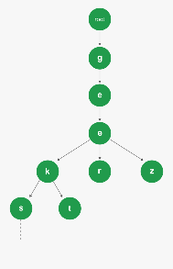
Future Proposals
11
Recommendation system
Semantic Search
Items Recommendation system based on user’s past purchases using Machine Learning.
Semantic item search using Natural Language Processing
and Deep learning.
Augmented Reality
Trie Data Structure
Augmented Reality based navigation inside the store to visualize the items Physically.
Improved search efficiency for large Scale database ( time complexity - O(log n)).

Slide 12


12
Thank You!
Demo
Please install the given apk file in the deliverables or visit the below URL for Prototype Demo
www.appdemostore.com/embed?id=6536086011510784

Slide 13

Questions?
13

